Slide 1
LYRE Personalized Music Recommendations

Slide 2
Meet the Team !
Anju Ann Sunny
Nikitha Mary Thomas
Nimisha Parameswaran Thankamani

Slide 3
Table of contents
01
02
03
04
05
06
Project Overview
Objectives & Target Audience
Key Features
Live Demo
Challenges Faced
Future Enhancements

Slide 4
What is Lyre?
Lyre is a cutting-edge music recommendation platform designed to enhance your music discovery experience. By analyzing user preferences, listening habits, and feedback, Lyre delivers personalized music suggestions tailored to your unique tastes. The app leverages advanced machine learning algorithms and integrates with popular music streaming services, like Spotify, to curate playlists that resonate with your musical inclinations.

Slide 5
01
Project Overview

Slide 6

The Problem
With millions of songs available, discovering new music that fits your taste can be overwhelming.
There is a need for a more refined and user-centric music discovery tool.

Slide 7
02
Objectives & Target Audience

Slide 8


Project Objectives
Target Audience
Develop an AI-driven app that offers personalized music recommendations.
Enhances user experience through personalized playlists.
Music enthusiasts looking for personalized recommendations.
Users who enjoy exploring new music but want tailored suggestions.

Slide 9





Technology Stack
Frontend
Backend
APIs
React, Vite
Flask, Python, SQLite
Spotify API

Slide 10
03
Key Features

Slide 11
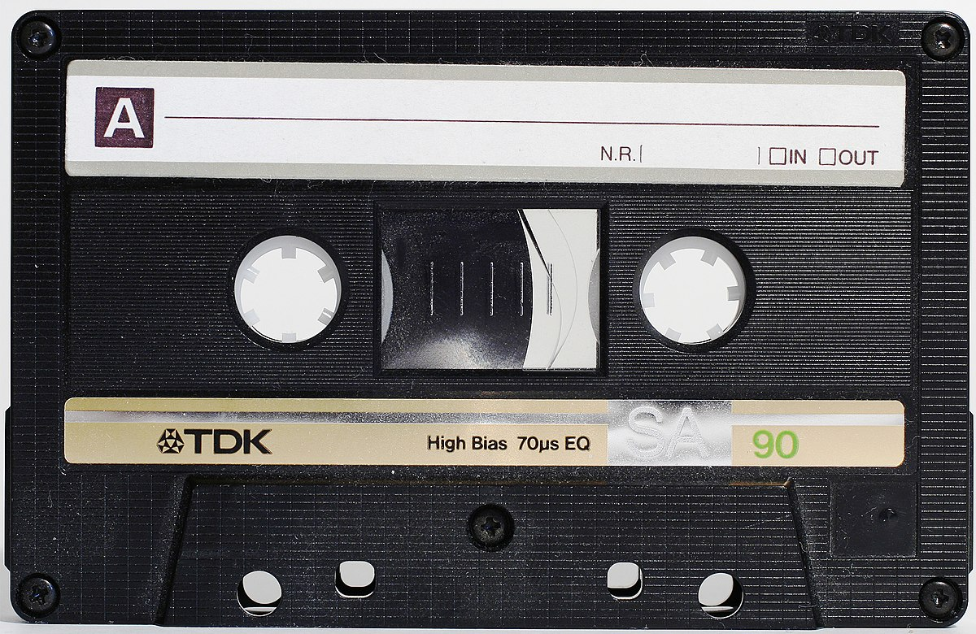
Key Features of Lyre
Personalized Playlists: Curated playlists based on user preferences.
Real-Time Recommendations: Updates based on user input.
Emotion-Based Recommendations: Recommendations based on user’s emotion through a camera input.
Voice Search: Easily search for music using voice.
Feedback System : For tailoring future recommendations based on user feedback.

Slide 12
04
Live Demo
https://lyreapp.onrender.com/

Slide 13
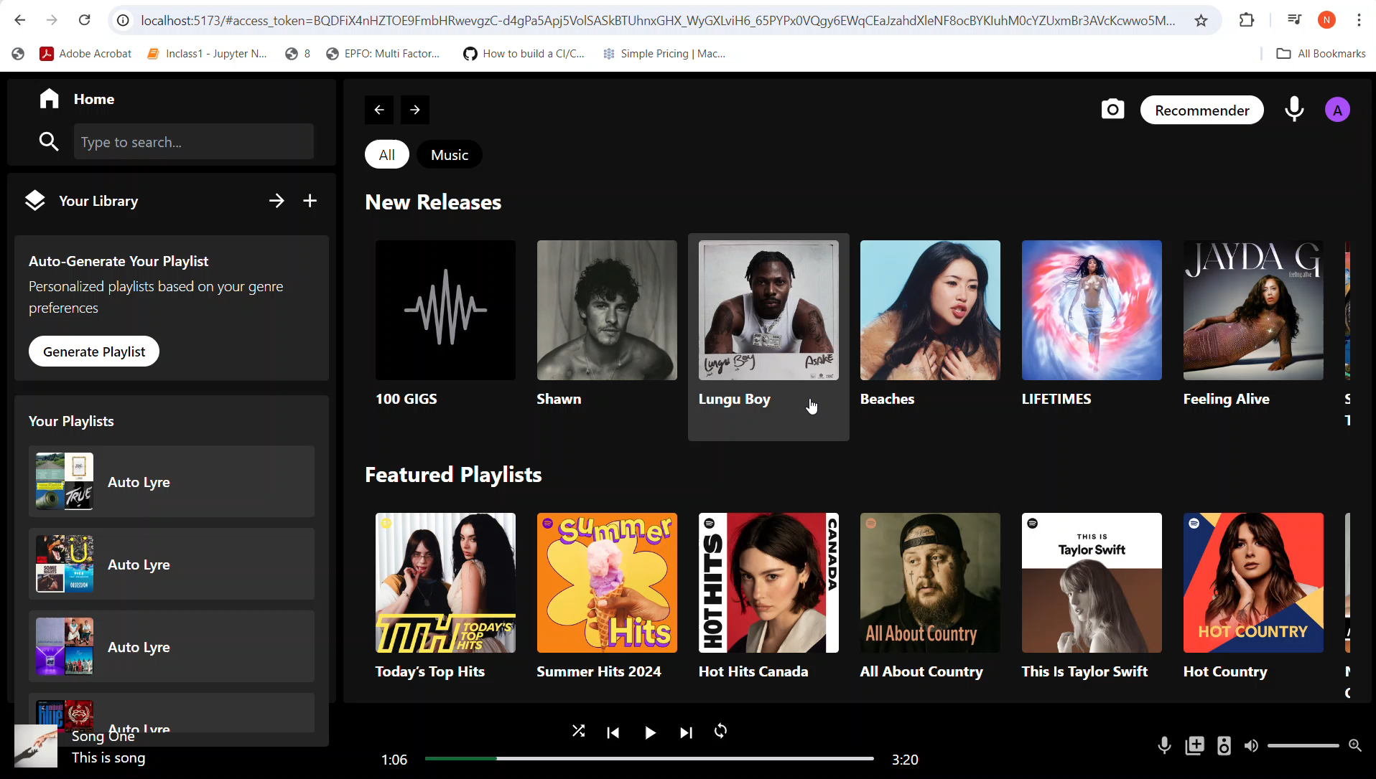

Slide 14
05
Challenges Faced

Slide 15


Camera Processing Post-Deployment:
After deploying Lyre, issues arose with the camera processing feature, causing conflicts in processing user input.
API Integration:
Handling Spotify API rate limits and parsing large datasets.

Slide 16
06
Future Enhancements

Slide 17




Social sharing
More genre options
What’s Next?
Expanding the user base
More features

Slide 18
Wrapping Up

Slide 19

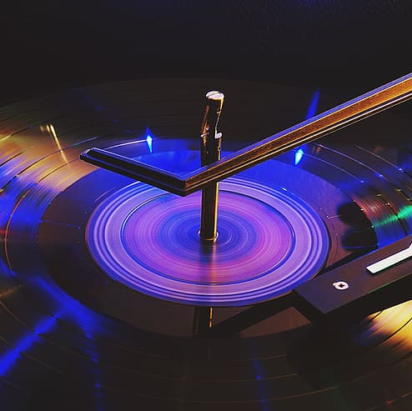
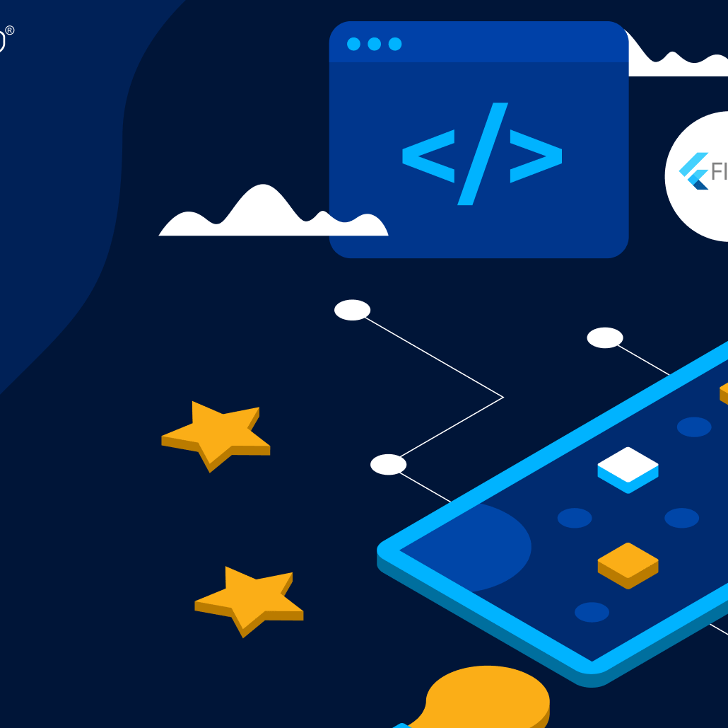
Lyre addresses the need for personalized music discovery.
The project has been a significant learning experience in AI, UI/UX design, and app development.

Slide 20
Thank You !

